Slide 1
Group Name
Haroon, Esher, Bill
RAL Visitor Centre
07.07.23

Slide 2
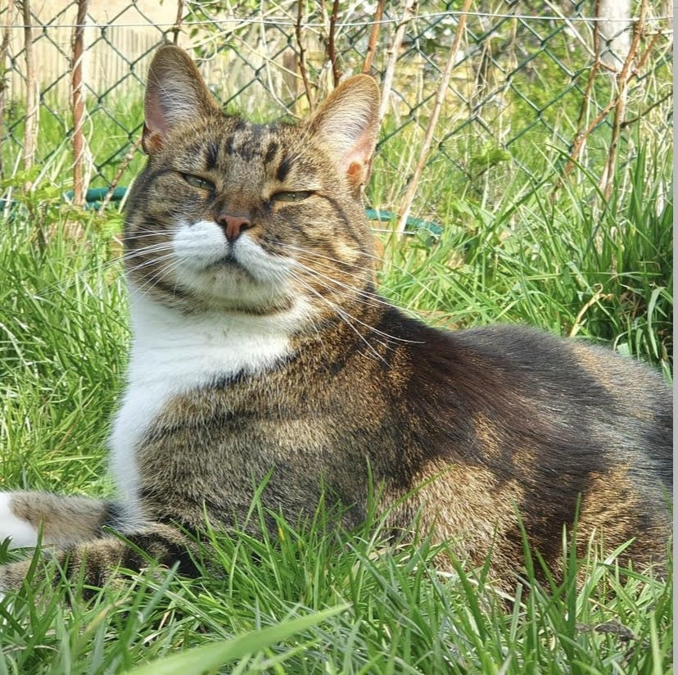
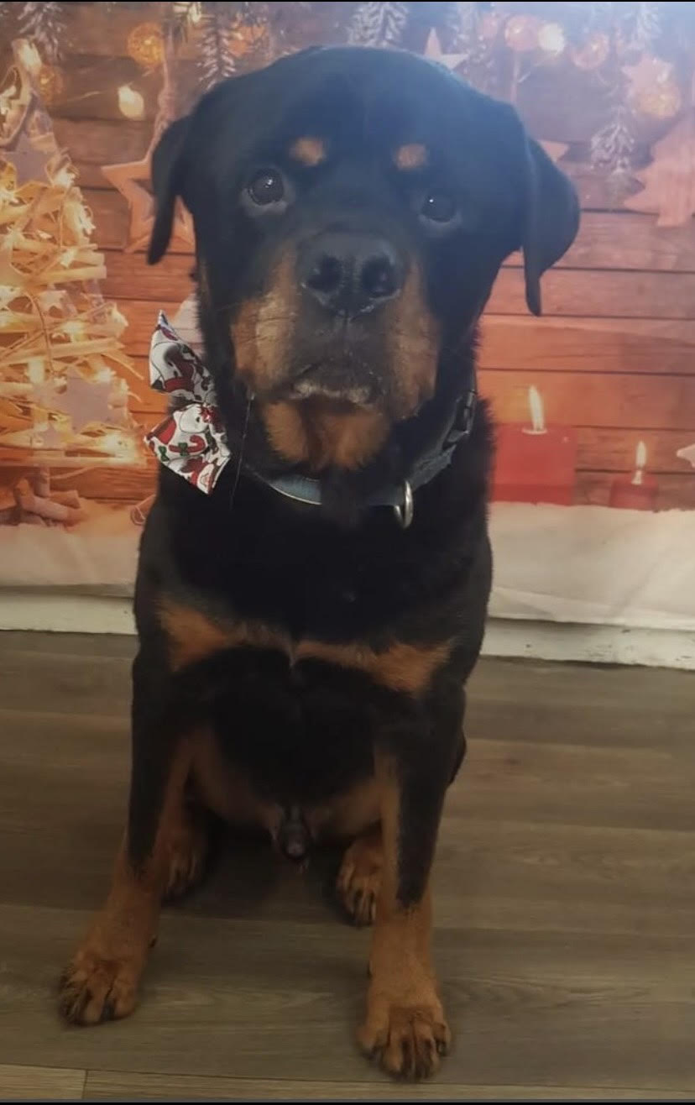
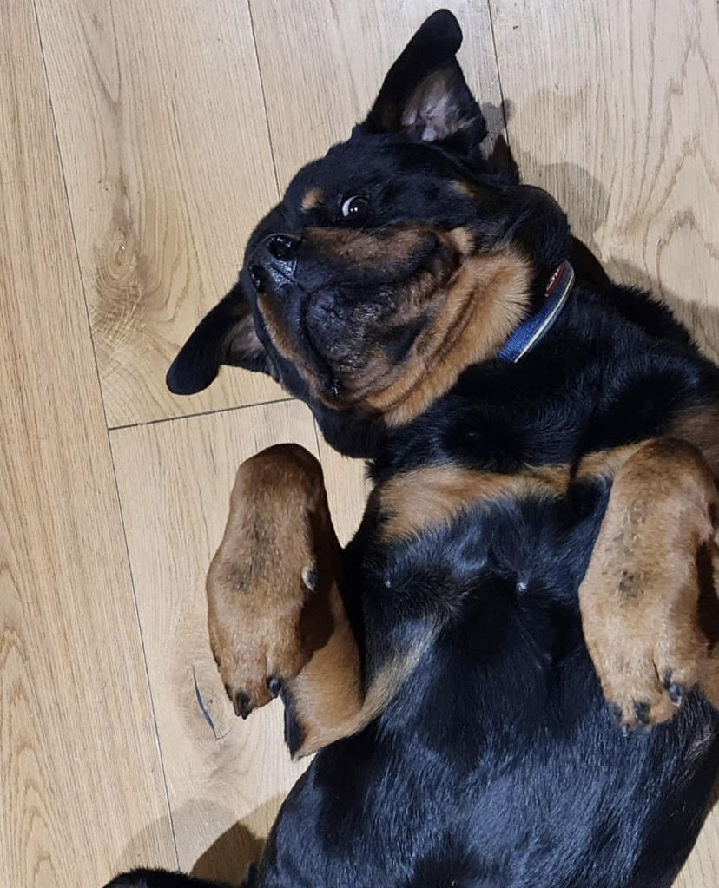
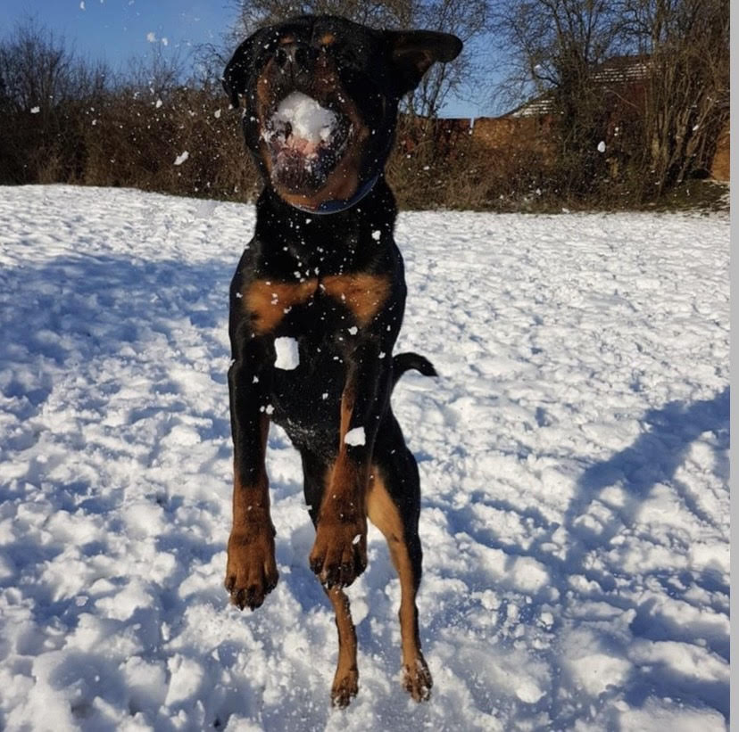
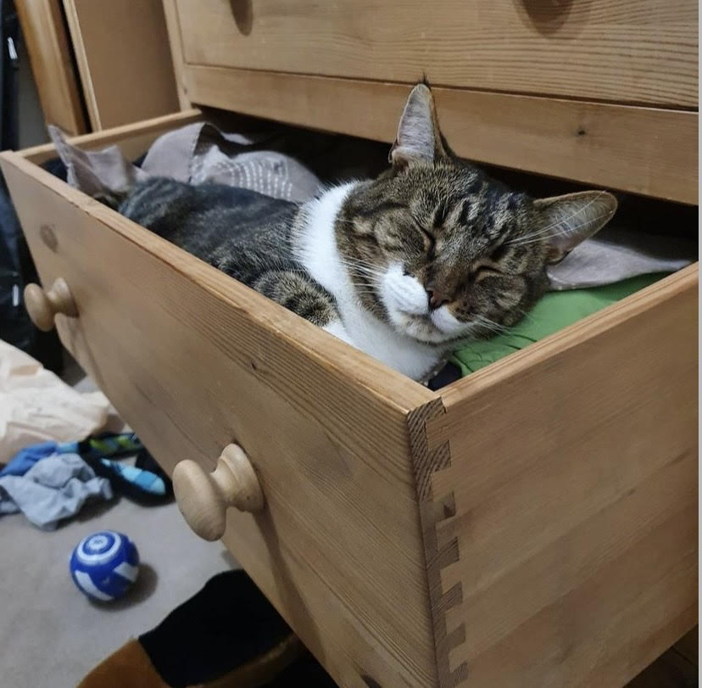
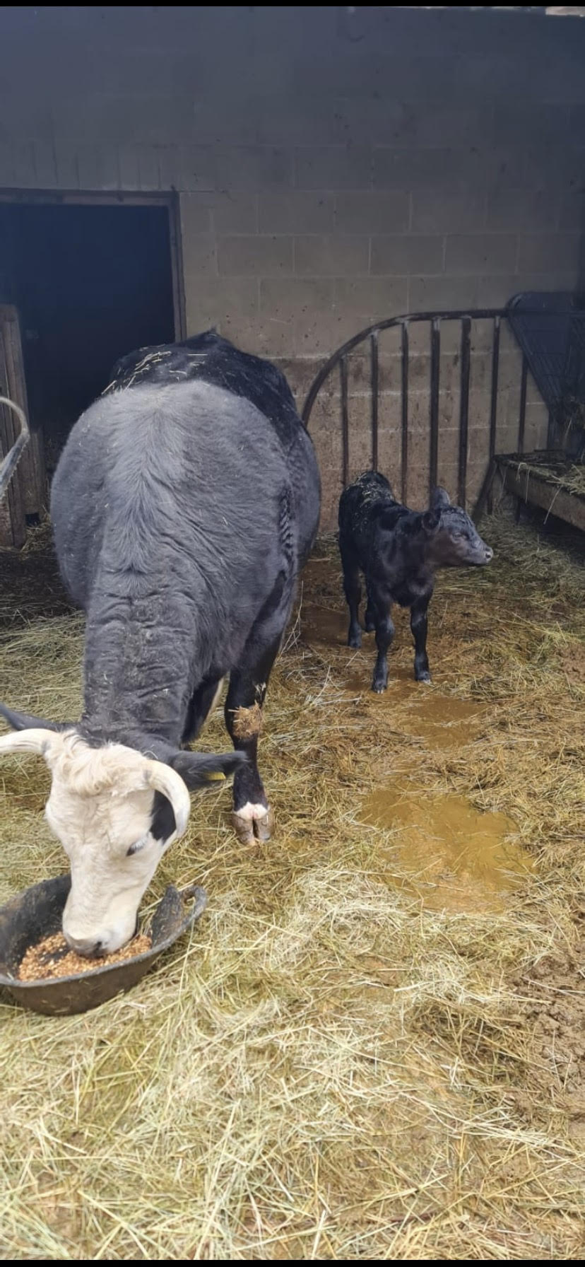
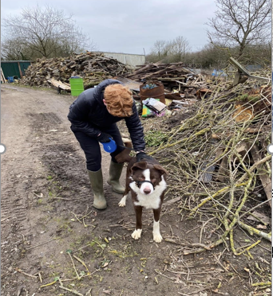
About me!
My life:
Jonah
My main hobby is playing Sunday league football for a team called croft but I sometimes play other sports as well. I started playing Ice Hockey a few months ago but my local rink closed down so I haven’t been able to keep playing.
I have a dog called Olaf and a cat called Jango which I love very much.
I also volunteer at an animal shelter, first for DofE but I continued to volunteer because I
developed such a great connection with the animals.
This has been a brilliant experience for me and I feel like I have learnt so much more python
than I knew before.
I am possibly going for a career in science or engineering which I have realised involves a
lot of coding from the guest speeches (they were very helpful for me to gain an idea of future job
aspirations).

Slide 3

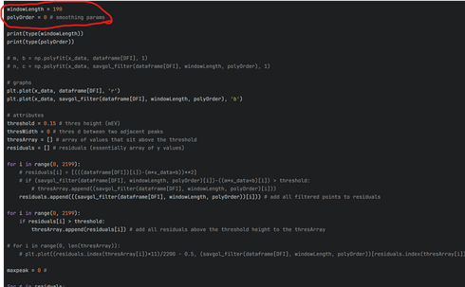
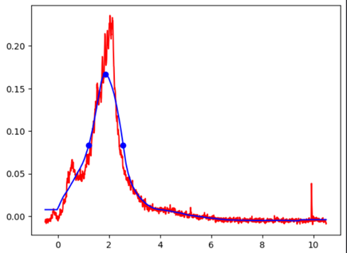
Stage 1 Projects: Group 1D: Peak Finding
My part:
Started by the find_peaks function on the internet.
Peak prominence. RIP Prominence: gone but never forgotten.
I found the optimum dimensions for the smoothing line so that we could use different peak finding restrictions to find the peaks.
I learnt how to utilise python functions as I have little python experience and I learnt how useful the internet is when struggling with coding.
I enjoyed using python and learning much more than the basics I am learning at school.
I struggled with the advanced python but tried my best to contribute to the team.

Slide 4
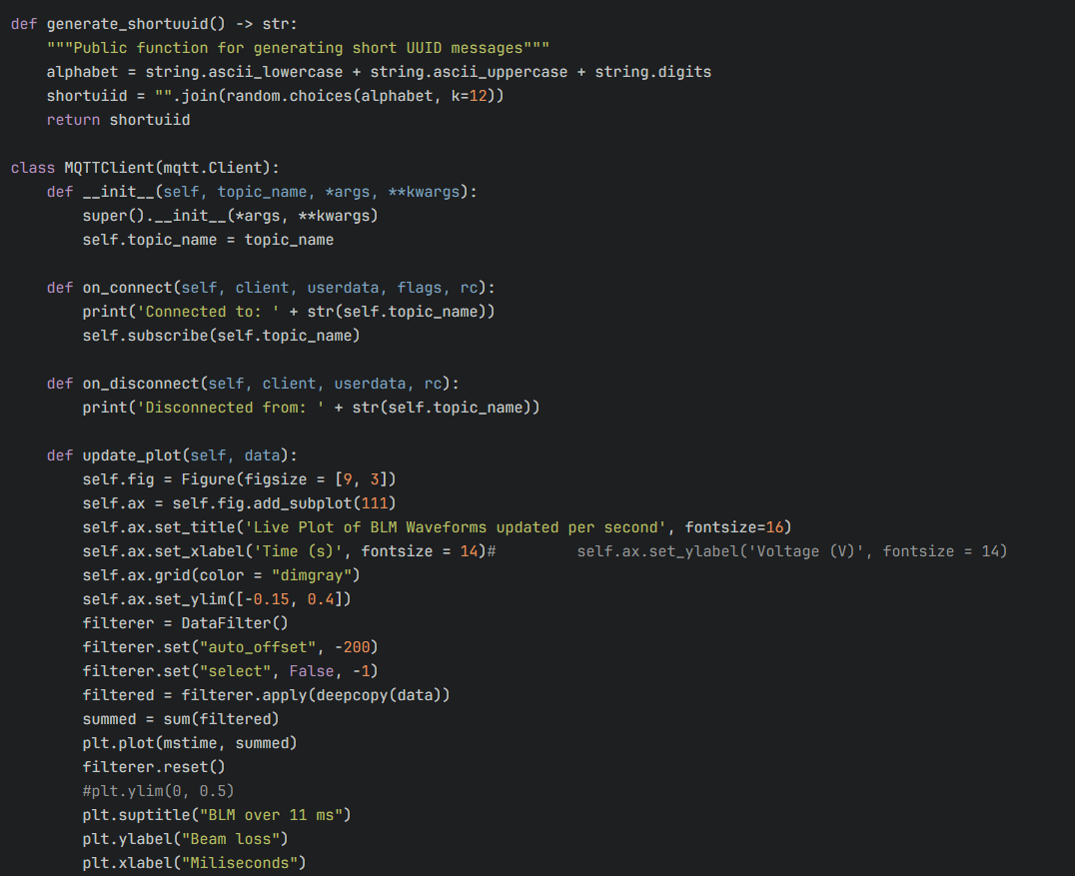
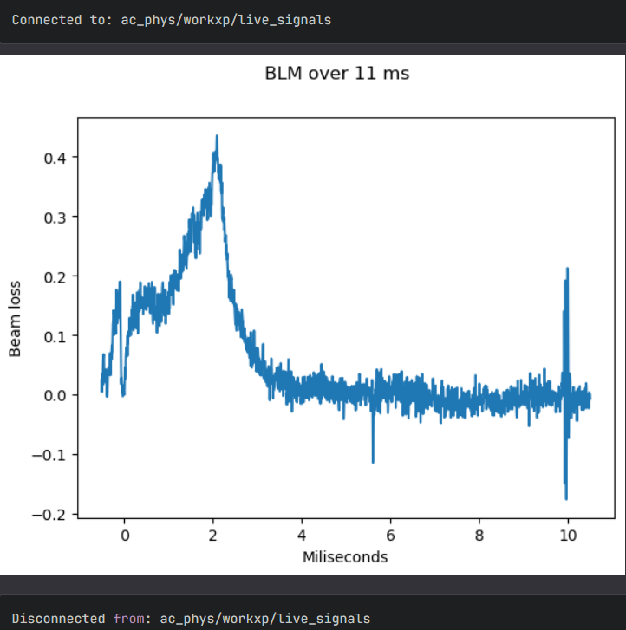
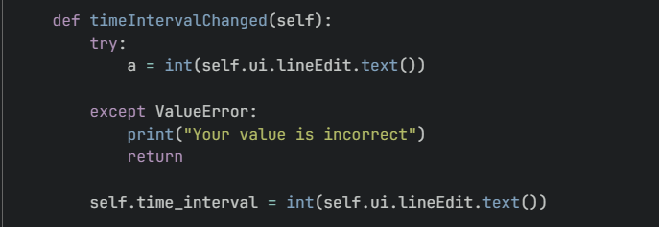
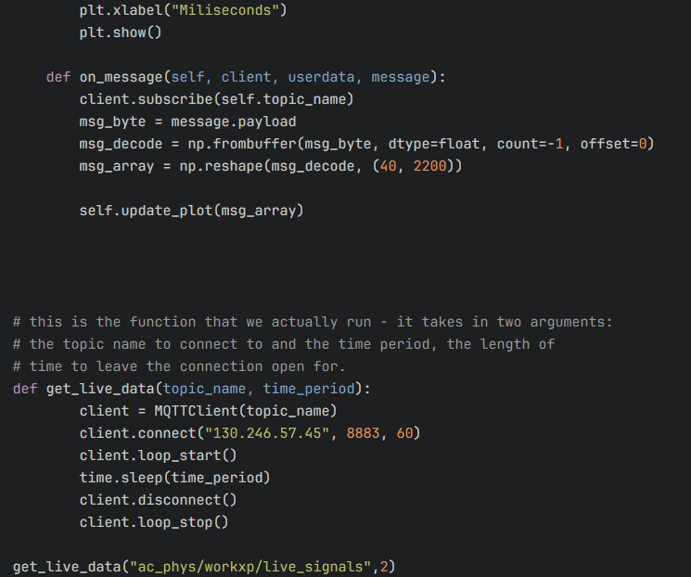
Stage 2 Projects: Peak Finding / R51M Loss
Data frequency function
MQTT code ->
BLM sum data from MQTT
←
My part:
I created a piece of code which allowed MQTT to upload live
data straight to the GUI( sum of BLMs).
Collaborated with other groups to improve my code and add
Group 1As data filter.
Created a data frequency function which allows users to
change the frequency (Hz) of the plotted data.
I learnt how to code functions and take data using mqtt and print plots of data.
I have become much more confident with python (still need a LOT more practice).

Slide 5
Each human should take a copy of this template, and fill in the above 3 slides
Each human should rename this template to their first name and save it
One human from each GUI group collect these templates and put them together (open 2 powerpoint instances and copy/paste the slides from the left menu), edit the title slide, acknowledgements, etc

Slide 6
Acknowledgments
We are privileged to do a job that we love, and one that serves so many. In order to do big science we require vast teams and incredible people who support our work. We must always acknowledge those who contribute to our success.
Our cleaner Pamela sanitises every desk in the building, vacuums our biscuit crumbs, mops the floors, disposes of our cups and napkins, carries our refuse to the industrial bins, ensures we have clean toilets, and often moves furniture, every day before we arrive.
Our reception team have had to phone a grumpy physicist on every occasion that you forgot your badges, and often I’ve missed their calls so they’ve sorted you out anyway. That’s a lot of unnecessary hassle for them.
Our public engagement (PE) team have read ~ 700 wx applications, sifted and sorted your applications, so that we could select you individually. All other wx students have a desk wherever their supervisor can find space. The PE team have not only granted us their space for 2 weeks, but the use of their laptops. We have exceptionally been granted use of their personal kitchen.
Please delete the above message and keep it simple:
Public Engagement Team
Etc

Slide 7
GUI Demo
5 minutes max, show live data, demo mode, change some settings and show features

Slide 8
Thank you
Questions?

